Slide 1

WORLD POPULATION ANALYSIS
Mahendra Nagdeve
© All rights reserved by Fireblaze Technologies Pvt. Ltd.

Slide 2
Problem Statement
🌍 Analyze global population data to understand demographic trends.
📈 Identify countries with high/low population growth.
🔍 Examine relationships between population growth, birth/death rates, migration, and land usage.
🌐 Compare demographic indicators across regions and income groups.
📊 Visualize data through charts and graphs for clearer insights.
🧠 Provide insights to support planning, policy-making, and sustainable development.
© All rights reserved by Fireblaze Technologies Pvt. Ltd.

Slide 3
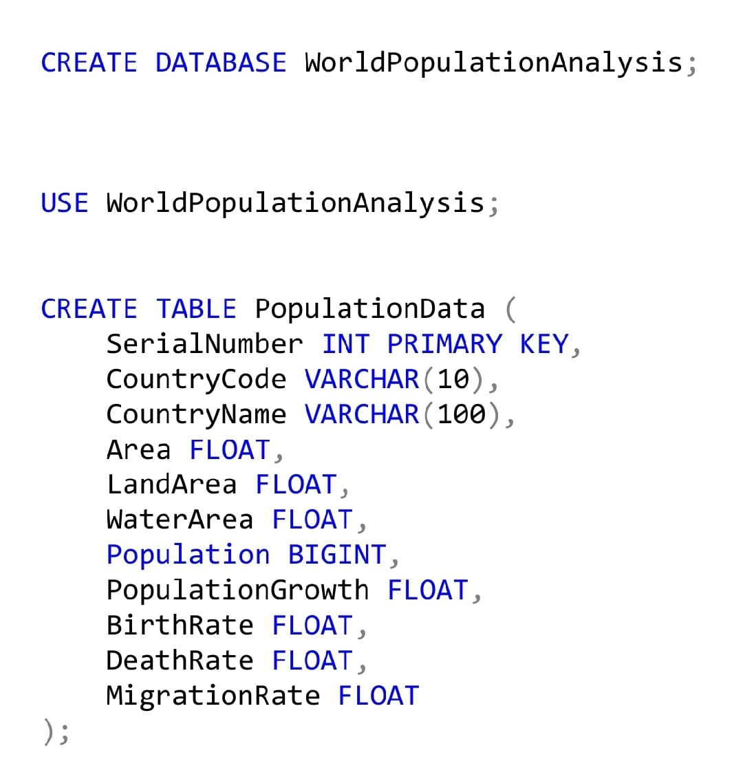
About the Data
Database Creation
Table Creation
© All rights reserved by Fireblaze Technologies Pvt. Ltd.

Slide 4
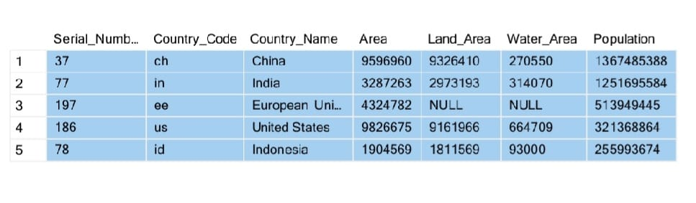
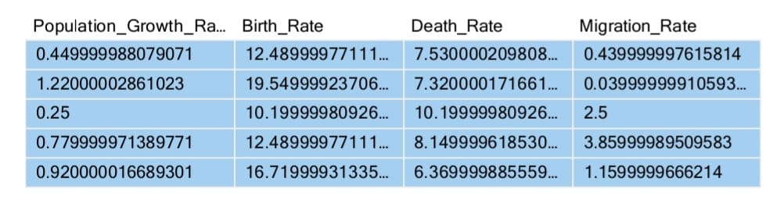
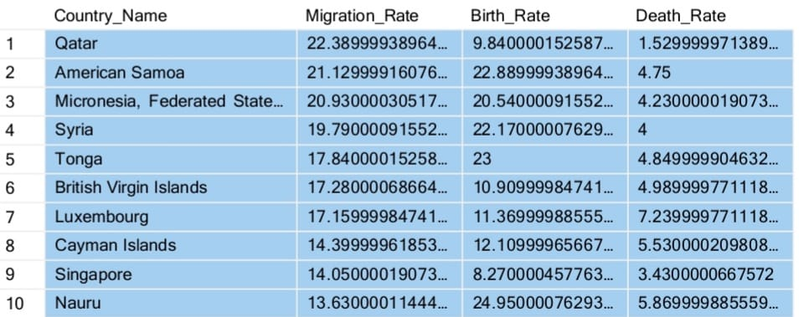
Proposed Solution
l
1.Top 5 countries by population growth:
select top 5 * from [dbo].[Dataset]order by Population desc;
2.Migration & Birth-Death Trends
Compare migration with birth and death rates:
High migration impact :
SELECT TOP 10 Country_Name, Migration_Rate, Birth_Rate, Death_Rate
FROM [dbo].[Dataset]
ORDER BY ABS(Migration_Rate) DESC;
© All rights reserved by Fireblaze Technologies Pvt. Ltd.

Slide 5
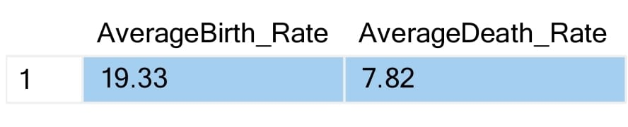
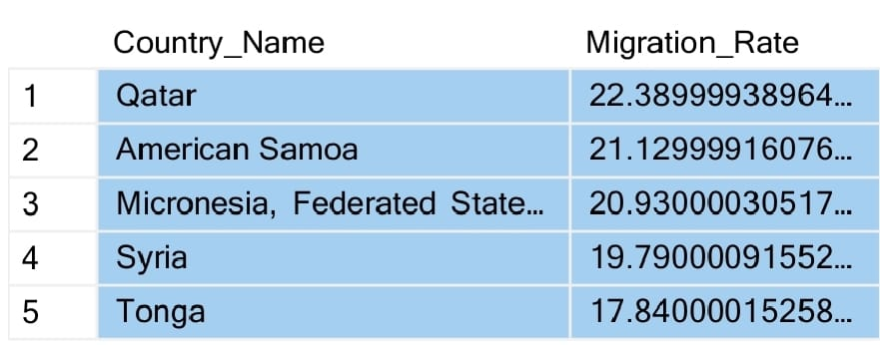
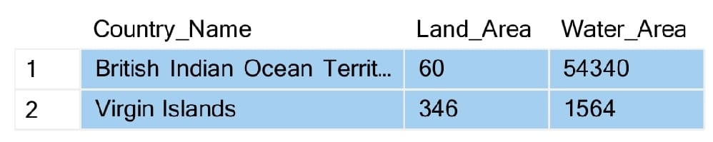
Proposed Solution
l
3. What is the average birth rate and death rate globally?
SELECT
ROUND(AVG(Birth_Rate), 2) AS AverageBirth_Rate,
ROUND(AVG(Death_Rate), 2) AS AverageDeath_Rate
FROM [dbo].[Dataset] ;
4. Which countries have the highest migration rate?
SELECT TOP 5 Country_Name, Migration_Rate
FROM [dbo].[Dataset]
ORDER BY Migration_Rate DESC;
5.Which countries have more water area than land area?
SELECT Country_Name, Land_Area, Water_Area
FROM [dbo].[Dataset]
WHERE Water_Area > Land_Area;
© All rights reserved by Fireblaze Technologies Pvt. Ltd.

Slide 6
Conclusion
Global population is steadily increasing, especially in Asia and Africa.
Some countries face high population density, straining resources.
Growth rates vary—some nations grow fast, others face decline.
Migration affects population balance, especially in developed countries.
Sustainable development is key to managing future population growth.
© All rights reserved by Fireblaze Technologies Pvt. Ltd.

Slide 7
Future Scope
Predict future population trends using advanced data models.
Analyze the impact of urbanization and migration on resources.
Support policy-making for healthcare, education, and housing.
Help plan sustainable development and infrastructure growth.
Identify regions at risk due to overpopulation or population decline.
Enable better global cooperation on population-related challenges.
© All rights reserved by Fireblaze Technologies Pvt. Ltd.

